Slide 1
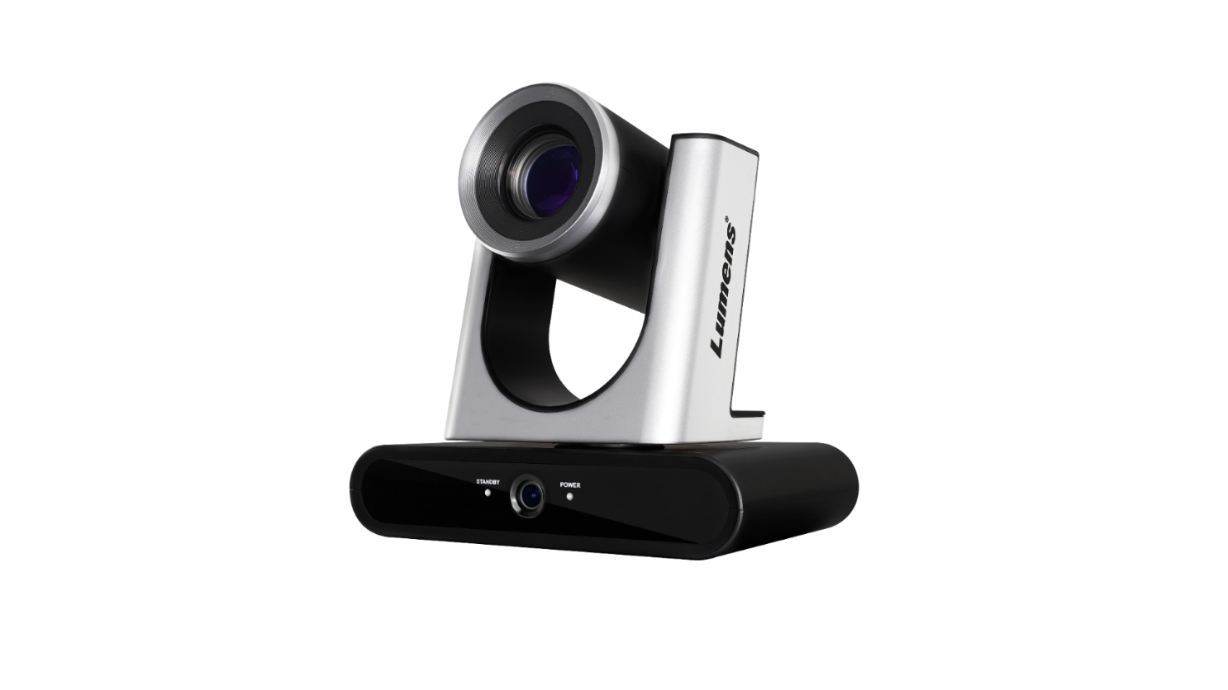
VC-TR40
AI Auto Tracking Camera
Product Introduction
Notes:
Let’s see the new product introduction. AI Auto Tracking Camera, VC-TR40

Slide 2
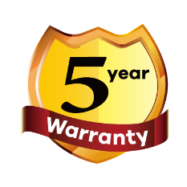
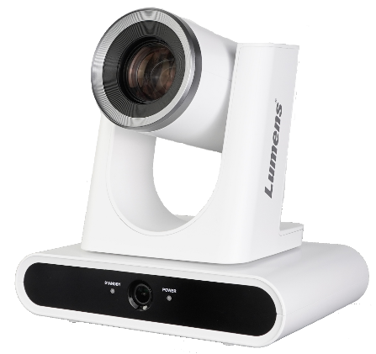
Overview
VC-TR40
AI Auto Tracking Camera
Color: Black, White
NDAA/TAA Compliant: Yes
Warranty: 5-Year
Replace VC-TR1
MAP: $1,899
Notes:
VC-TR40 is a dual-lens auto-tracking camera. Its AI-powered human face recognition and gesture control technology makes it easier than ever to track the subject.
The color is available in black and white.
It is NDAA and TAA Compliant. and it comes with 5-year warranty.

Slide 3
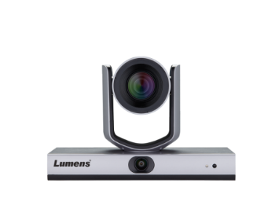
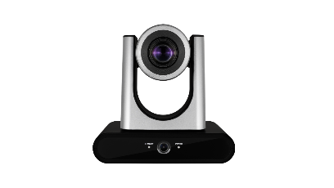
Product Family
VC-TR40
VC-TR1
MAP Price(USD$) | $ 1,899 | $ 2,999
Video Format | 1080p60 | 1080p60
Video Output Interface | 3G-SDI, HDMI, Ethernet, USB3.0 | 3G-SDI, HDMI, Ethernet, USB2.0
Optical Zoom | 20x | 20x
Image Flip | YES | NA
Reliable AI Tracking | YES | NA
USB Output | 1080p60 | 1080p30
IP Streaming | RTSP, RTMP, RTMPS, SRT | RTSP, RTMP, RTMPS
PoE | PoE (IEEE802.3af) | PoE+ (IEEE802.3at)
Notes:
VC-TR40 is the replacement model for VC-TR1.
Compare with VC-TR1, VC-TR40 with USB 3 output and can be mounted upright or inverted. With AI Tracking, VC-TR40 can follow a subject smoothly and reliably, making it ideal for use in presentations, conferences, worship services, studios, and lecture halls.

Slide 4
Product I/O
VC-TR40 Front View
Lens
Pan Tilt Robotics
IR Receiver
Panoramic lens
Notes:
VC-TR40 is a dual-lens auto-tracking camera, featuring a 1080p 60fps image processor and a 20x optical zoom lens.
Its secondary panoramic camera can analyze the whole view while the main camera is capturing an individual.

Slide 5
Product I/O
VC-TR40 Back View
RS-232
Audio In
USB 3.0
DC 12V
3G-SDI
HDMI
ETHERNET
Notes:
On the back, it has USB 3, HDMI, 3G-SDI, audio in, Ethernet and RS-232 port.

Slide 6
Recommended installation
Distance & Height
Tracking distance: 2 ~ 15 m
Optimal tracking distance: 8 m
Vertical mounting height: 2 ~ 3 m
Optimal installation height: 2.4 m
Notes:
The Recommended installation Tracking distance range is 2 to 15 meters. Optimal tracking distance is 8 meters.
Vertical mounting height is 2 to 3 meters. Optimal installation height is 2.4 meters.

Slide 7
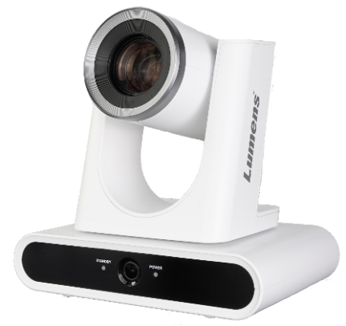
Key Features
AI-Powered Human Face Recognition
3 Tracking modes and 2 Framing modes
Mount upright or inverted
HDMI, Ethernet, 3G-SDI, USB simultaneous output
1080P 60fps with 20x Optical Zoom
Notes:
Here are some key features of VC-TR40
AI-Powered Human Face Recognition
3 Tracking modes and 2 Framing modes
Mount upright or inverted
HDMI, Ethernet, 3G-SDI, USB simultaneous output
1080P 60fps with 20x Optical Zoom

Slide 8
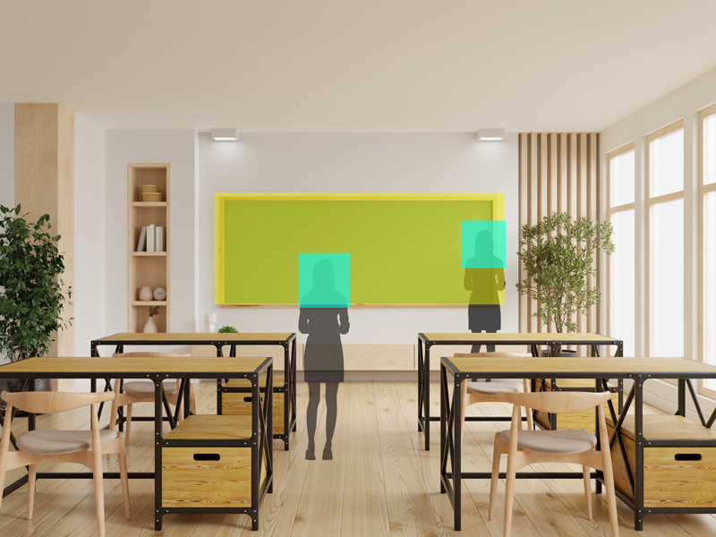
Selling Point
Everywhere Tracking
In the Everywhere Tracking mode, the camera will continuously track the presenter’s movement left and right, forwards and backwards.
Notes:
VC-TR40 has 3 Tracking modes ,
1. Everywhere Tracking
In the Everywhere Tracking mode, the camera will continuously track the presenter’s movement left and right, forwards and backwards.

Slide 9
Selling Point
Stage Tracking
In Stage Tracking mode, the VC-TR40 will pan left and right to follow a presenter within a defined area.
Notes:
2. Stage Tracking
In Stage Tracking mode, the VC-TR40 will pan left and right to follow a presenter within a defined area.

Slide 10
Selling Point
Partition Tracking
When the presenter moves inside a user-defined Partition Area, the camera switches to a preset angle and zoom.
When outside a Partition Area, the camera autonomously follows the presenter.
Notes:
3. Partition Tracking
When the presenter moves inside a user-defined Partition Area, the camera switches to a preset angle and zoom. When outside a Partition Area, the camera autonomously follows the presenter.

Slide 11
Selling Point
Auto Framing
VC-TR40 will dynamically adjust to capture all delegates, re-framing the view if participants join or leave during the session.
Partition Framing
The camera will go to a preset position when the presenter walks in to partition area.
When the presenter walks out the area, the camera will go back to Auto-Framing mode.
Notes:
VC-TR40 has 2 framing modes ,
With the Auto-framing function,
VC-TR40 will dynamically adjust to capture all delegates, re-framing the view if participants join or leave during the session.
In Partition-Framing mode,
The camera will go to a preset position when the presenter walks in. When the presenter walks out the area, the camera will go back to Auto-Framing mode.

Slide 12
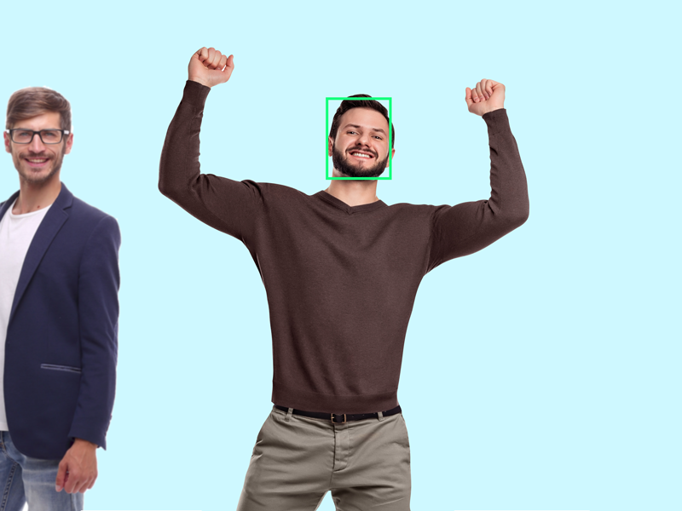
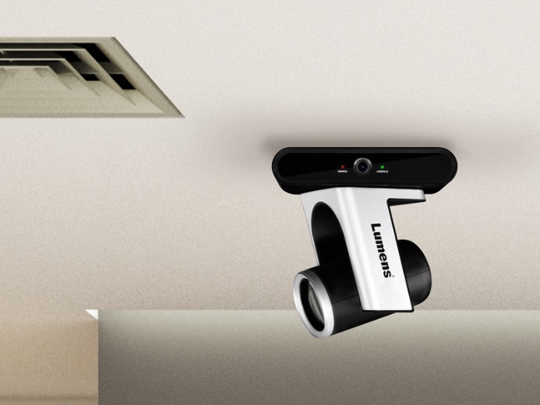
Selling Point
Gesture Control Tracking Method
Flexible Mounting
The VC-TR40 features advanced gesture control. When the presenter raises their hands, the tracking target will switch automatically. You can also manually change the tracked subject by selecting the individual via the web interface or remote control.
The VC-TR40 can be positioned upright or suspended from the ceiling installation. When inverted, the camera can re-orient the image and flip the camera controls.
Notes:
Gesture Control Tracking Method
The VC-TR40 features advanced gesture control. When the presenter raises their hands, the tracking target will switch automatically. You can also manually change the tracked subject by selecting the individual via the web interface or remote control.
Flexible Mounting
The VC-TR40 can be positioned upright or suspended from the ceiling installation. When inverted, the camera can re-orient the image and flip the camera controls.

Slide 13
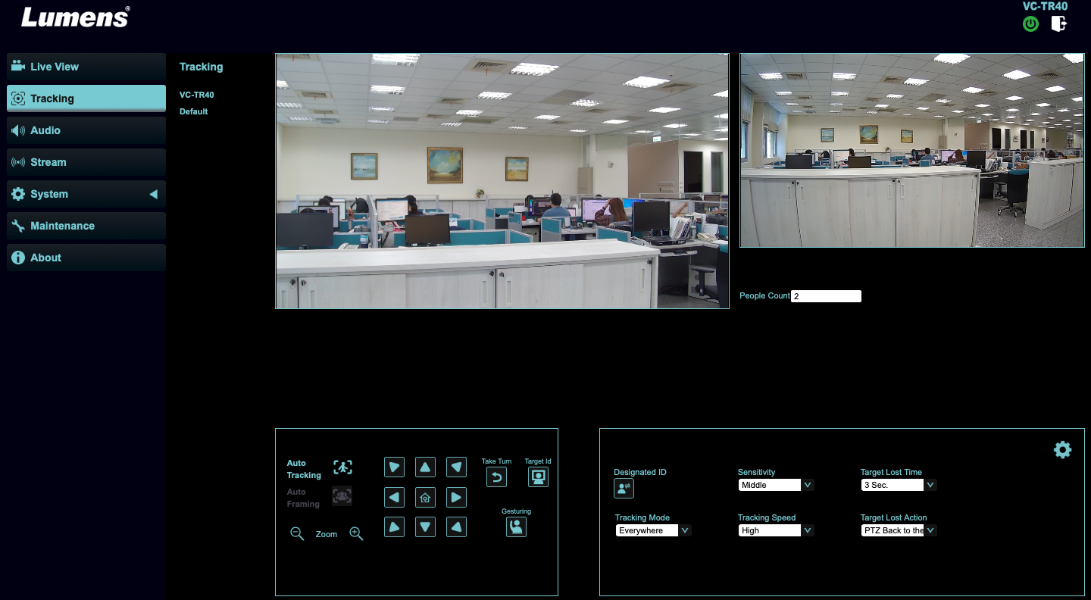
Selling Point
Easy to setup tracking mode through webpage
You can easily set up the VC-TR40 tracking setting through the webpage. With the preview main window and panoramic preview, it clearly sees the current capture range and object.
No matter whether you would like to change the tracking mode, set the block or partition area, or switch the tracking object, you can easily modify it through the webpage.
Notes:
Easy to setup tracking mode through webpage
You can easily set up the VC-TR40 tracking setting through the webpage. With the preview main window and panoramic preview, it clearly sees the current capture range and object.
No matter whether you would like to change the tracking mode, set the block or partition area, or switch the tracking object, you can easily modify it through the webpage.

Slide 14
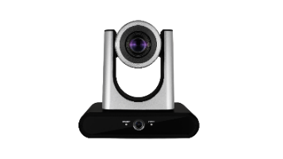
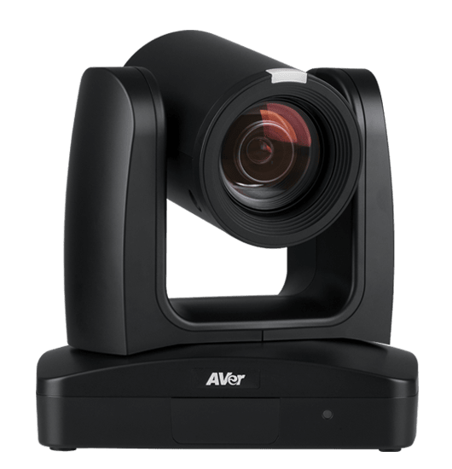
Competitive Product
Lumens VC-TR40
Aver TR311
Map Price(USD$) | $1,899 | $2,199
Video Format | 1080p60 | 1080p60
Video Output (HD) Interface | 3G-SDI, HDMI, Ethernet, USB3.0 | 3G-SDI, HDMI, Ethernet, USB3.0
Optical Zoom | 20x | 12x
Horizontal Viewing Angle | 58.7° | 70°
Auto Framing | Yes | NA
High Speed Preset | 120°/sec | 200°/sec
Smooth Pan/Tilt movement | Yes, 0.2°/sec | Yes, 0.1°/s
USB Output | 1080p60 | 1080p30
IP Streaming | RTSP / RTMP / RTMPS / SRT | RTSP / RTMP / SRT
Control Protocol | VISCA / PELCO D / ONVIF | VISCA / PELCO-D / CGI (IP)
Notes:
The competitor is Aver TR311. The price is $2,199.
Compare with Aver TR311, Lumens VC-TR40 has 20x optical Zoom, Auto-framing mode, 1080p 60 frame USB output, and supports more control protocol.

Slide 15
How to Switch the Tracking Target?
Remote Control
Auto Tracking
On/Off: Enable/Disable Auto Tracking
Full: Full body tracking
Upper: Half body tracking
Switch: Switch tracking object
Auto Framing
On/Off: Enable/Disable auto framing
Trigger: Manual framing correction
1
Remote Control
*VC-TR40 will reboot when you switch Auto Tracking and Auto Framing mode.
Notes:
How to switch the tracking target?
There are some methods you can switch the tracking target.
Remote control
There are some tracking buttons on the Remote control, you can turn on or turn off the Tracking or Framing mode, select full body or half body tracking. Or you can switch the tracking object.

Slide 16
How to Switch the Tracking Target?
2
Webpage
People Count
It will show how many people in Panoramic Lens.
Take Turn
Press the button while camera tracking, it will switch tracking target.
Target ID
It will show the available tracking target with green frame on panoramic lens, the red frame is current tracking target.
Gesturing
Turn on the gesture control, when the presenter raises their hands, the tracking target will switch automatically.
Designated ID
When this function turn on, you can use mouse to click the green frame on panoramic lens, VC-TR40 will track the person you select.
Webpage
Notes:
2. Webpage
No matter whether you would like to change the tracking mode, set the block or partition area, or switch the tracking object, you can easily modify it through the webpage.
You can press Take Turn button to switch tracking target.
Turn on Target ID to show available tracking target .
Turn on the Gesture control, when the presenter raises their hands, the tracking target will switch automatically.
If you turn on the Designated ID, you can use mouse to click the green frame on panoramic lens, VC-TR40 will track the person you select.

Slide 17
How to Switch the Tracking Target?
Gesture Control
Turn on the gesture control on the webpage setting , when the presenter raises their hands, the tracking target will switch automatically.
3
Gesture Control
Notes:
3. Gesture Control
Turn on the gesture control on the webpage setting , when the presenter raises their hands, the tracking target will switch automatically.

Slide 18
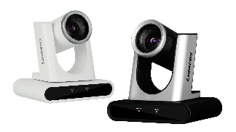
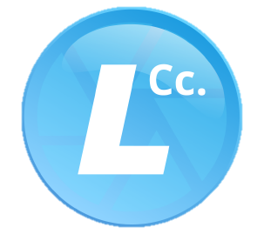
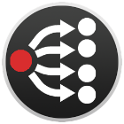
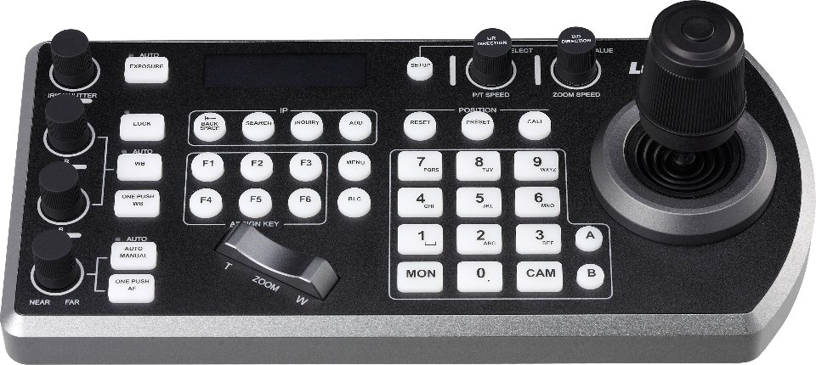
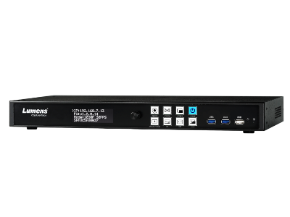
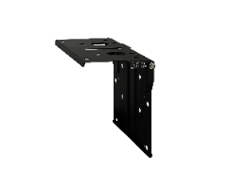
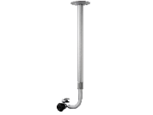
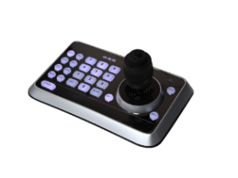
Lumens Products
Integration
VC-TR40 is compatible with Lumens products like media processor LC200, LC100 and Camera controller VS-KB30, VS-KB20.
VC-TR40
It is also compatible with Lumens software like CamConnect, Deployment Tool, Virtual camera…, providing users use more convenience.
Software
Mounting
VS-KB30
LC200
WM14
WM15
VS-K20
LC100
Media Processor
Accessory
Controller
Notes:
VC-TR40 is compatible with Lumens products like media processor LC200, LC100 and Camera controller VS-KB30, VS-KB20.
It is also compatible with Lumens software like CamConnect, Deployment Tool, Virtual camera…, providing users use more convenience.

Slide 19
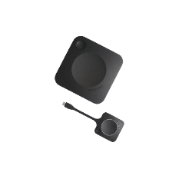
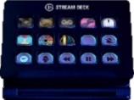
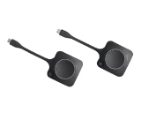
Third Party Partners
Integration
VC-TR40 successfully integrates with major Video Conference software, popular streaming platforms, broadcasting software, stream deck and Barco ClickShare.
It provides users with more flexible options to use VC-TR40 with their desired platforms.
Stream Deck
Barco ClickShare
Video Conference
Streaming Platform
Broadcasting Software
Notes:
VC-TR40 successfully integrates with major Video Conference software, popular streaming platforms, broadcasting software, stream deck and Barco ClickShare. It provides users with more flexible options to use VC-TR40 with their desired platforms.

Slide 20
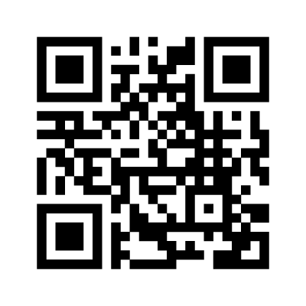
More information
Notes:
For more information, please visit our website at www.Mylumens.com

